Slide 1
Deep Visual-Semantic Alignments for Generating Image Descriptions (2015)
Andrej Karpathy Li Fei-Fei
(kaparthy@cs.stanford.edu) (feifeili@cs.stanford.edu)
Presentation by - Vritti S Rohira

Slide 2
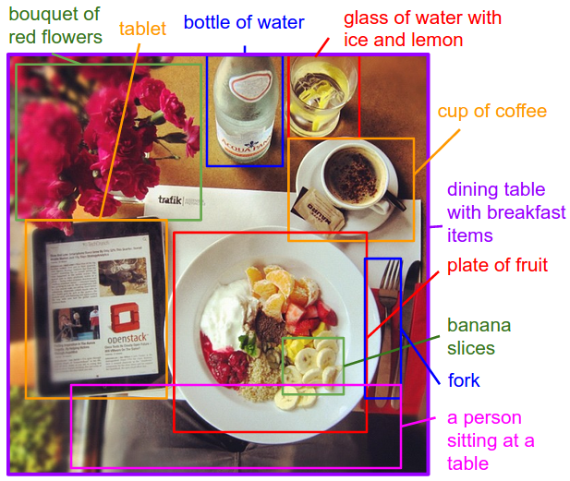
Motivation
Developing a model to generate natural language descriptions of images and their regions
Motivation from Previous Work
Rely on sentence templates
Fixed set of visual categories
Reduction to a single sentence
AIM :
Generating dense descriptions of images

Slide 3
Introduction
What we saw last week in class : CONTENT EXTRACTION
Methods to extract content
RELATED/PREVIOUS WORK
Dense image annotations
Generating descriptions
Grounding Natural Language in images
Neural Networks in visual and language domains
Notes:
Dense image annotation – holistic scene understanding – scene type, objects and their spatial support BUT focusing on fixed set of categories
Generating descriptions – log-bilinear model, fixed context window, retrieval problem
Grounding natural language – words & images through a semantic embedding
Neural network – pretrained word vectors

Slide 4
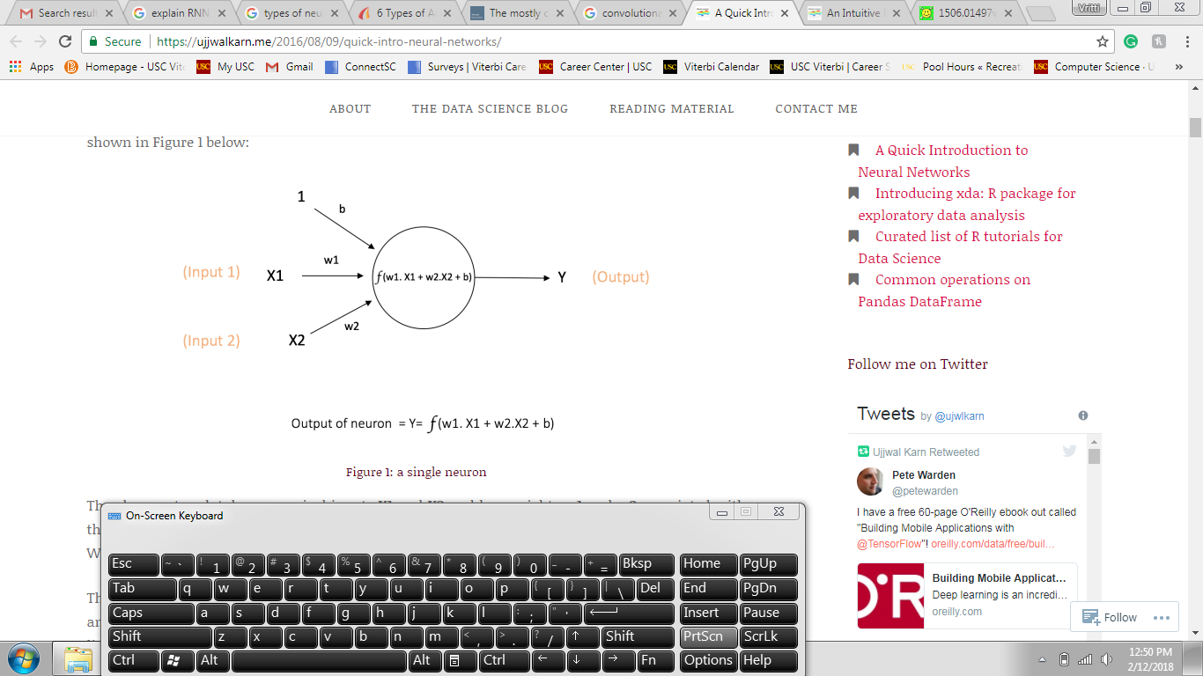
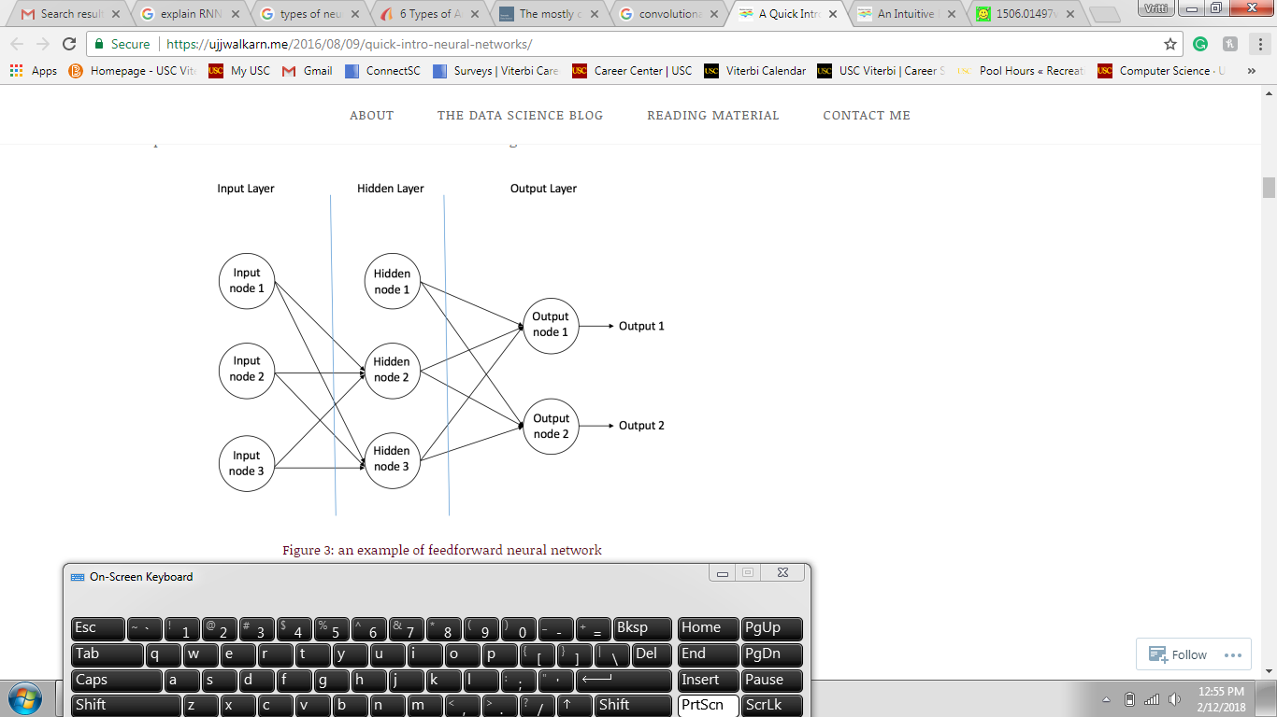
Background: Look Into Neural Networks
Building blocks
A single neuron/ perceptron
A feed forward neural network
Notes:
Artifical Neural Networks : associated weight (w), which is assigned on the basis of its relative importance to other inputs.
The function f is non-linear and is called the Activation Function. The purpose of the activation function is to introduce non-linearity into the output of a neuron. This is important because most real world data is non linear and we want neurons to learn these non linear representations.
Bias:
https://www.quora.com/What-is-bias-in-artificial-neural-network
https://stackoverflow.com/questions/2480650/role-of-bias-in-neural-networks

Slide 5

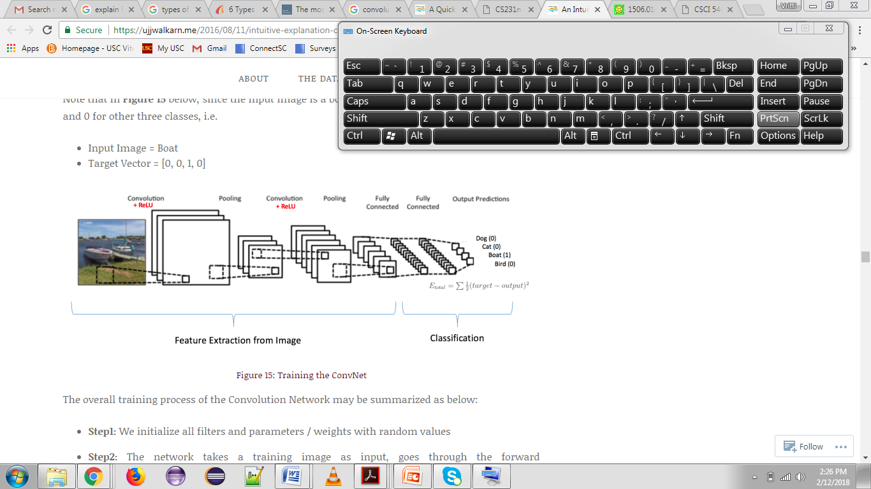


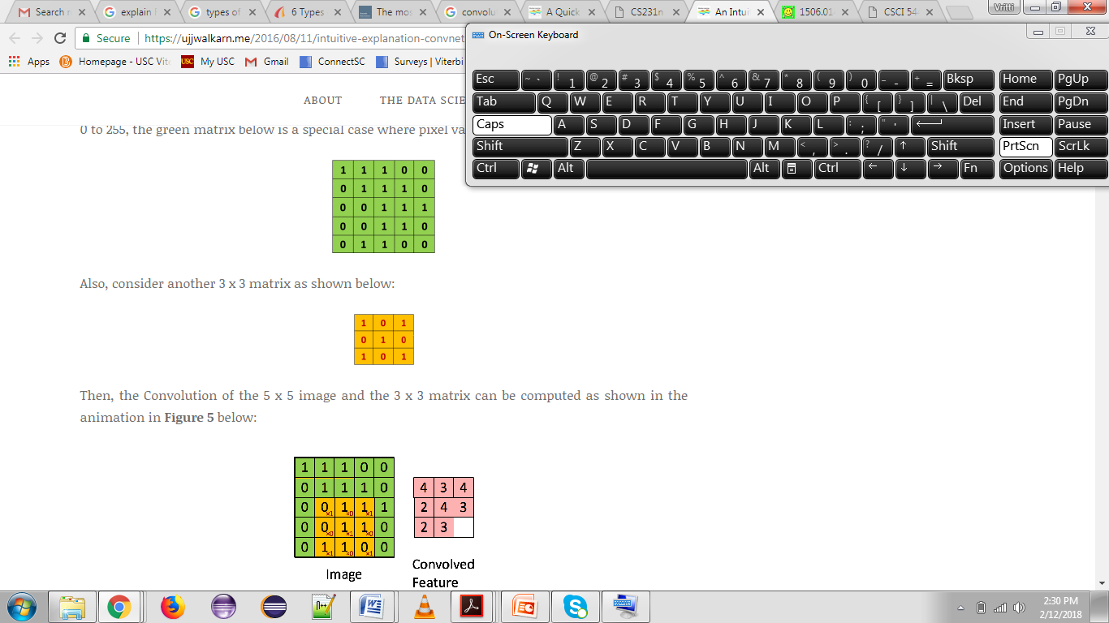
Convolutional Neural Networks (CNNs)
ARCHITECTURE
1. a THE CONVOLUTION STEP
<-
Filter
Pixels from image
Notes:
LeNet : very first convolutional neural networks – initially used for character recognition tasks

Slide 6

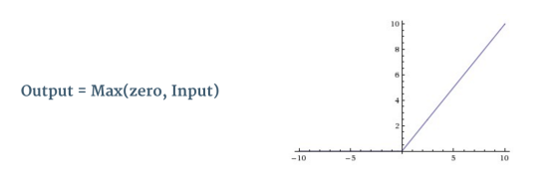
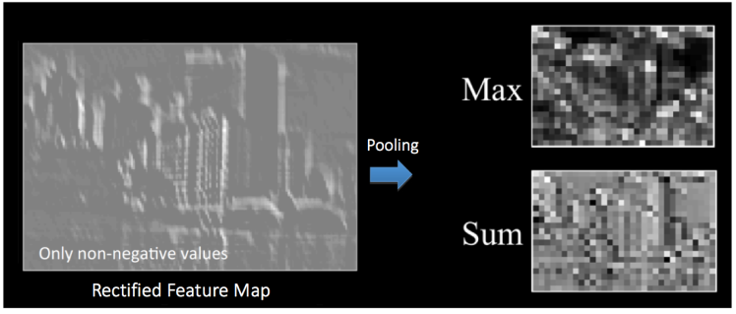
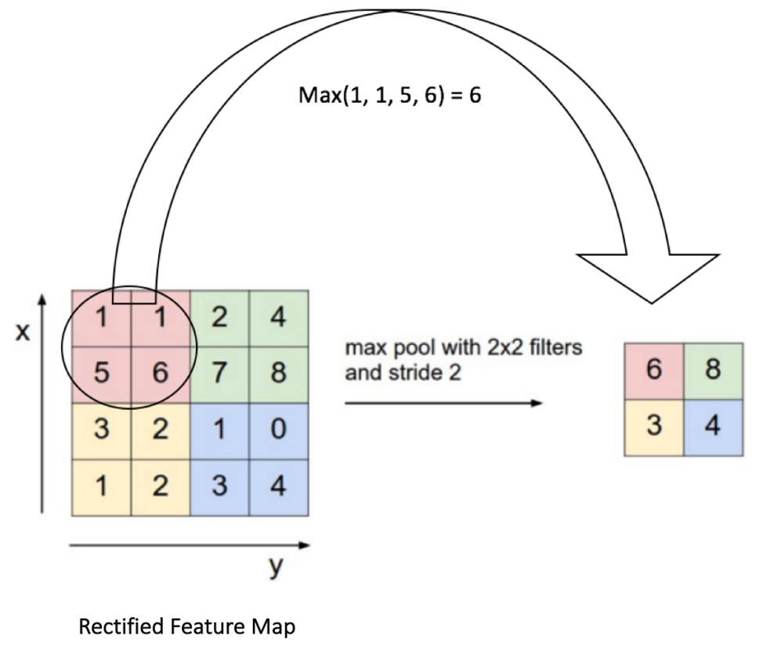
Convolutional Neural Networks (CNNs)
1. b THE ReLU STEP (introduces non linearity)
ReLU is an element wise operation (applied per pixel)
and replaces all negative pixel values in the feature map by zero.
2. THE POOLING STEP (dimensionality reduction)
3. THE FULLY CONNECTED LAYERS
Notes:
Advantages of pooling:
-makes the input representations (feature dimension) smaller and more manageable
-reduces the number of parameters and computations in the network, therefore, controlling overfitting [4]
-makes the network invariant to small transformations, distortions and translations in the input image (a small distortion in input will not change the output of Pooling – since we take the maximum / average value in a local neighborhood).
-helps us arrive at an almost scale invariant representation of our image (the exact term is “equivariant”). This is very powerful since we can detect objects in an image no matter where they are located (read [18] and [19] for details).

Slide 7

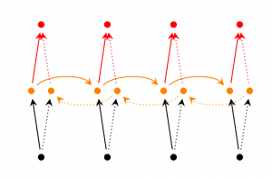
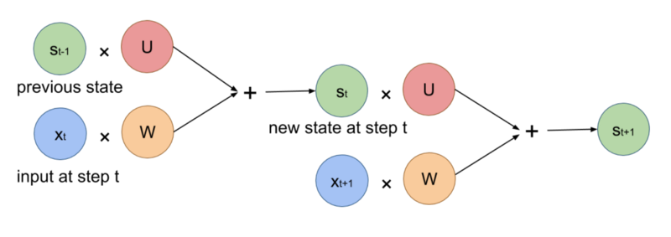
Recurrent Neural Networks
Basic Vanilla RNNs
Bidirectional RNNs
Notes:
For example a well trained RNN on generating sentences should learn to encode the fact it opened a bracket at say time step 2 into h2h2, which gets carried forward in every step of computation, and the RNN will close the bracket at time step 10 with the use of h9. Note this recurrent connection will be used as part of the input computation at the next time step.
Bidirectional RNNs are based on the idea that the output at time may not only depend on the previous elements in the sequence, but also future elements. For example, to predict a missing word in a sequence you want to look at both the left and the right context. Bidirectional RNNs are quite simple. They are just two RNNs stacked on top of each other. The output is then computed based on the hidden state of both RNNs.

Slide 8
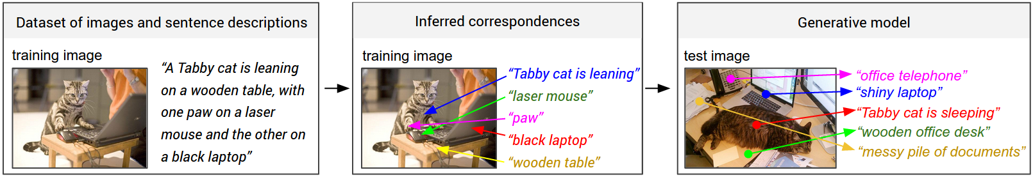
Part 1: Learning To Align Visual & Language Data
PROBLEM: Frequent references to some particular but unknown location in image
AIM: Infer these latent alignments between words and their objects they describe
APPROACH: Neural networks that map words and image in a common multimodal embedding
Notes:
Use BRNNs to dispense off the condition to depend only on few words as compared to unbounded interactions between words
Simplification of objective of Kaparthy which helps in improve performance

Slide 9
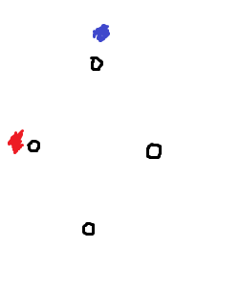
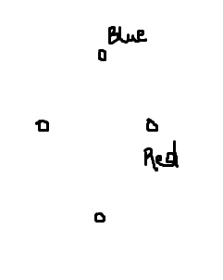
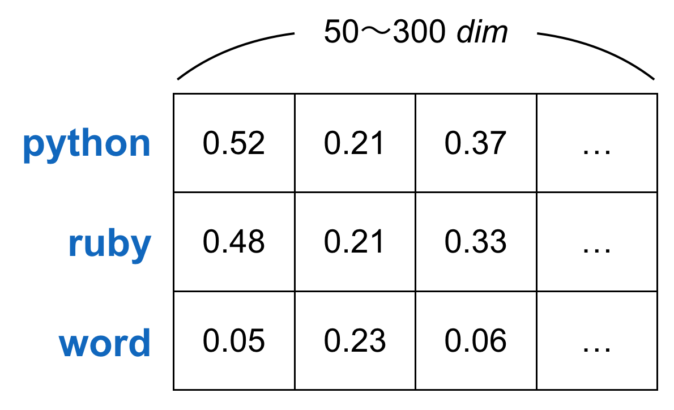
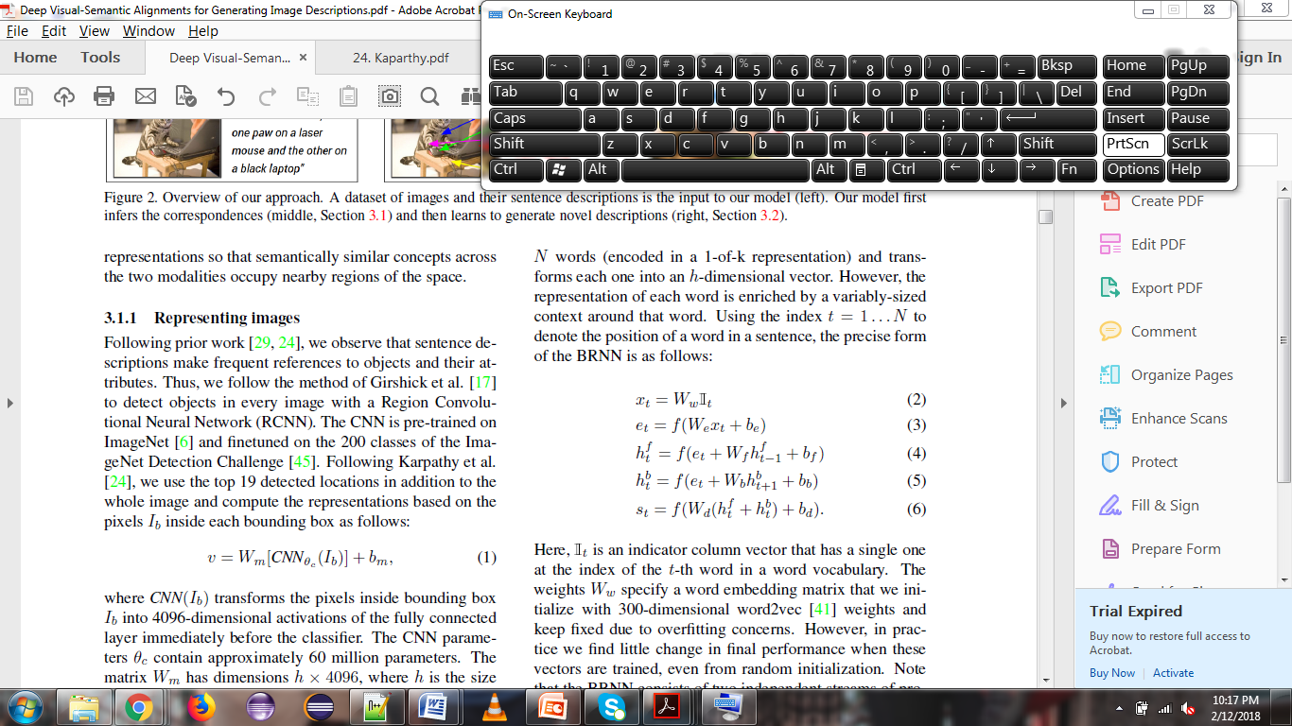

Part 1.1: Representing Images
Part 1.2 :Representing Sentences
TRAIN
Pre-train and finetune Regional CNN
Feed image to the trained CNN
FEED
Top 19 image locations + the whole image
Each location converts to a 4096 – dimensional activation for fully connected layer
The fully connected layer - weight matrix Wm having dimensions h*4096
Each image is a set of h-dimensional vectors
PREPOCESS
Pretrained Word embedding vector W_{w} ( 300-dimensions)
N words in sentence represented as one hot encoding
TRAIN
Run the bidirectional RNN and compute the output
Each sentence is a h-dimensional vector
Image vector
Text vector
Word embedding vector
We now have vectors in a common h-dimensional space
Notes:
Pretrain :On ImageNet dataset and finetune on ImageNet Detection Challenege dataset
Word embedding vectors –
1) skip gram model : Google data - https://papers.nips.cc/paper/5021-distributed-representations-of-words-and-phrases-and-their-compositionality.pdf
2) Global vectors - https://www.aclweb.org/anthology/D14-1162

Slide 10
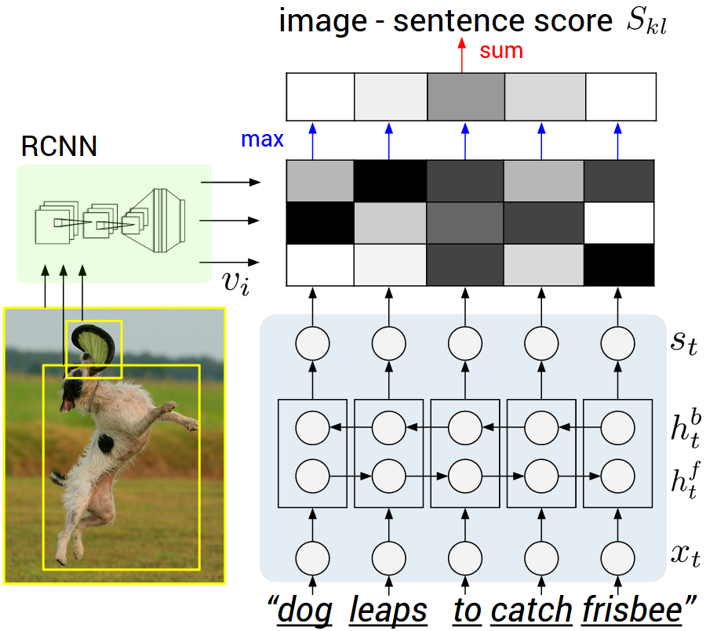
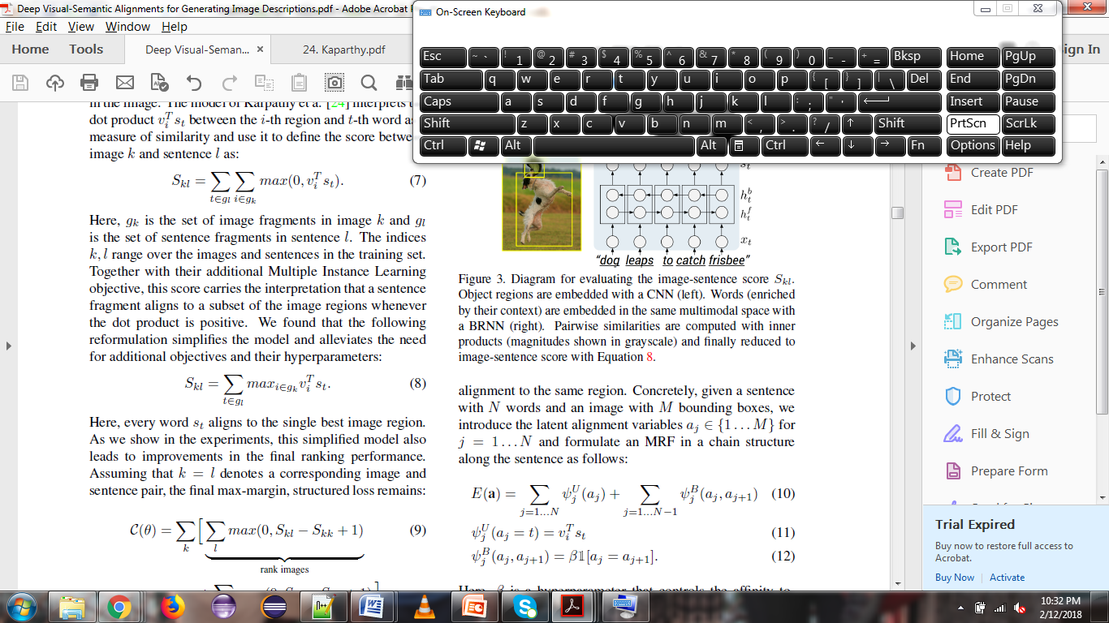
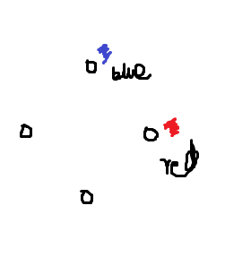
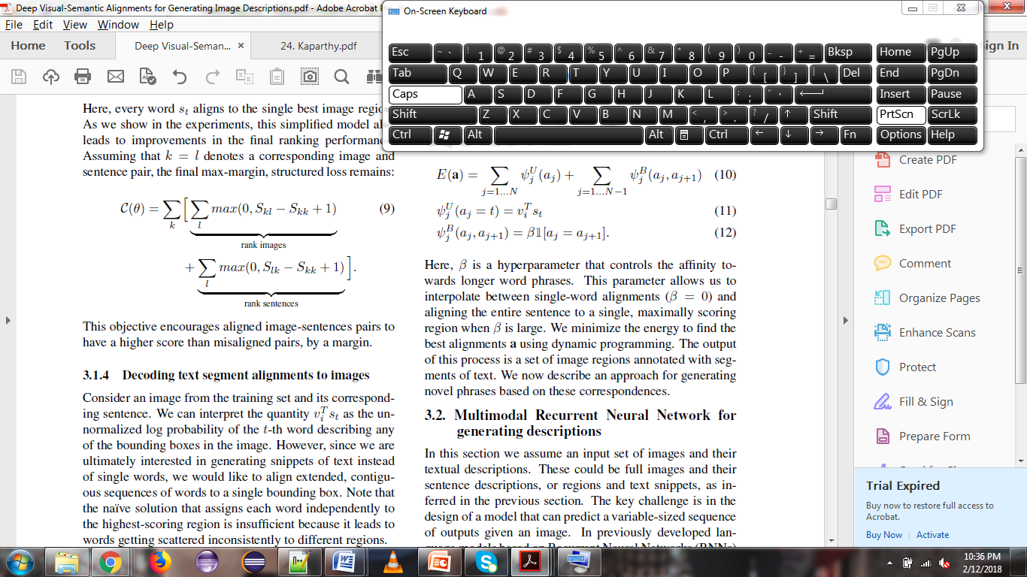
Part 1.3: Alignment Objective
Part 1.4: Decoding Text Segment Alignments To Images
Dot product as a measure of similarity
Fragment Alignment Objective
Global Ranking Objective
Align neighboring words to correspond to the same region using Markov Random Fields
Notes:
Good link to understand the MRF application in language :https://ermongroup.github.io/cs228-notes/representation/undirected/

Slide 11
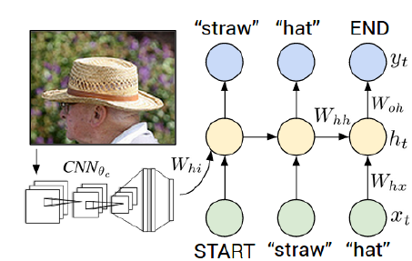
PART 2: Multimodal RNNs for generating descriptions
DATA
Full images& sentence descriptions/Regions or text snippets
Assign x₁= START, h₀= 0, y₁ = first word in sequence, x₂ = vector of 1st word… and finally y_{T} = END
TEST
Give x₁= START
Image context vector from CNN
Pick at each step argmax from distribution of words(beam size = 7)
TRAIN
RNNs using previous word, context from previous time step and image context vector
Notes:
We received input from a CNN which works on the given image. This CNN returns 4096-dimenions. We multiply this with the weight matrix which gives us image context vector bv. //This is given only at t = 1 ( as compared to at all time steps)
Then the hidden layers are computed
The output layer holds unormalized log probabilities of the is given out using softmax

Slide 12
EXPERIMENTS & RESULTS
Datasets:
Data sanitation:
Conversion to lower case
Discard non-alphanumeric characters
Filter words that occur at least 5 times in the training set
Dataset Name | Training Data Size | Validation Data Size | Test Data Size
Flickr8K | 6,000 | 1,000 | 1,000
Flick30K | 29,000 | 1,000 | 1,000
MS COCO | 1,30,000 | 5,000 | 5,000

Slide 13
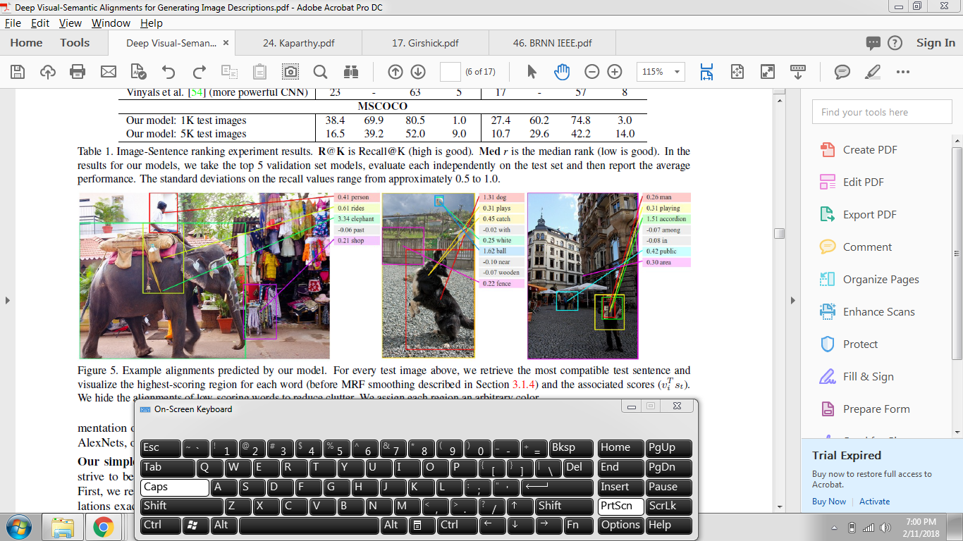
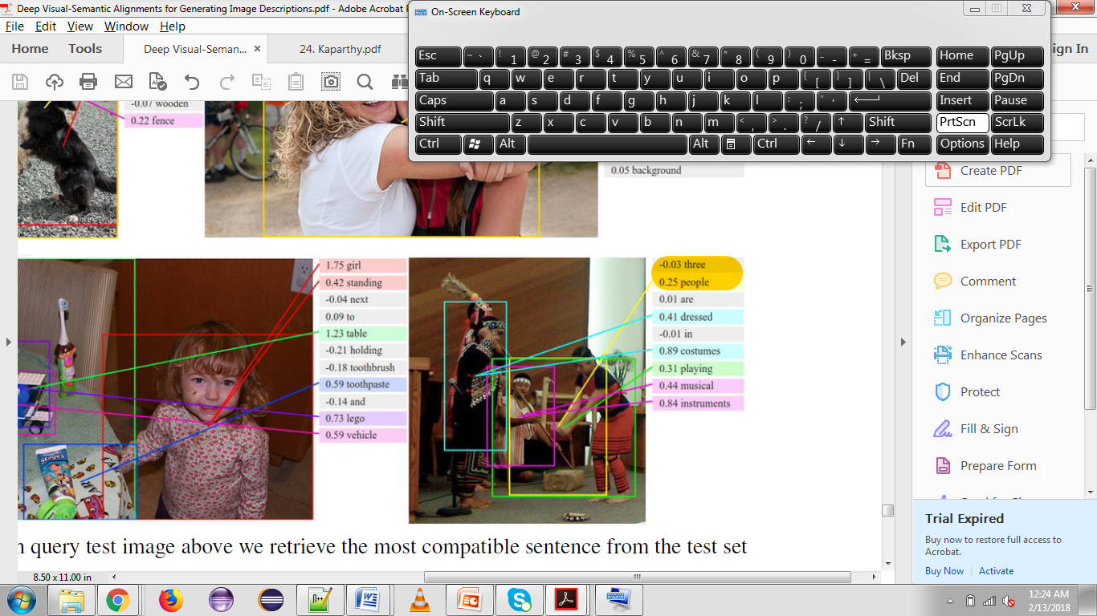
EXPERIMENTS & RESULTS : PART 1
Image – Sentence Alignment Evaluation
Notes:
What we do : We retrieve items in one modality given a query from the other by sorting based on the image-sentence score Skl.
--same loss, but over only image representation
--LSTM
-- more powerful CNN
Our implementation of Kaparthy *DeFrag
Removed BRNN and used Dependency Tree
BRNN outperforms dependency tree relations : our method used raw words directly and does not rely on extracting dependency tree
Qualitative: Model discovers the correspondences even for small objects such as the accordion
Good feature : learned regions and word vector magnitudes – discriminative words and objects have higher magnitude embedding vectors

Slide 14
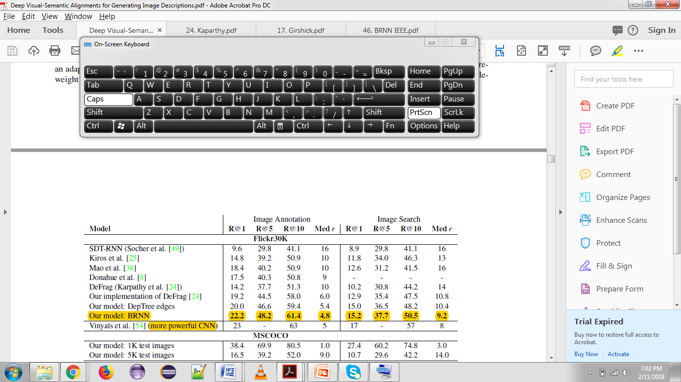

EXPERIMENTS & RESULTS : PART 1
Image – Sentence Alignment Evaluation
Comparison to previous work
BETTER! (except one)
Performance improvement
Simpler cost function
Qualitative aspect
Discovers small and rare objects
Query on annotation
Query on image
Notes:
More powerful CNN uses batch normalization in the CNN (uses end to end model – with LSTM)
To increase the stability of a neural network, batch normalization normalizes the output of a previous activation layer by subtracting the batch mean and dividing by the batch standard deviation.
Batch normalization reduces the amount by what the hidden unit values shift around (covariance shift). To explain covariance shift, let’s have a deep network on cat detection. We train our data on only black cats’ images. So, if we now try to apply this network to data with colored cats, it is obvious; we’re not going to do well. The training set and the prediction set are both cats’ images but they differ a little bit. In other words, if an algorithm learned some X to Y mapping, and if the distribution of X changes, then we might need to retrain the learning algorithm by trying to align the distribution of X with the distribution of Y. ( Deeplearning.ai: Why Does Batch Norm Work? (C2W3L06))
Also, batch normalization allows each layer of a network to learn by itself a little bit more independently of other layers.
https://machinelearningmastery.com/gradient-descent-for-machine-learning/

Slide 15
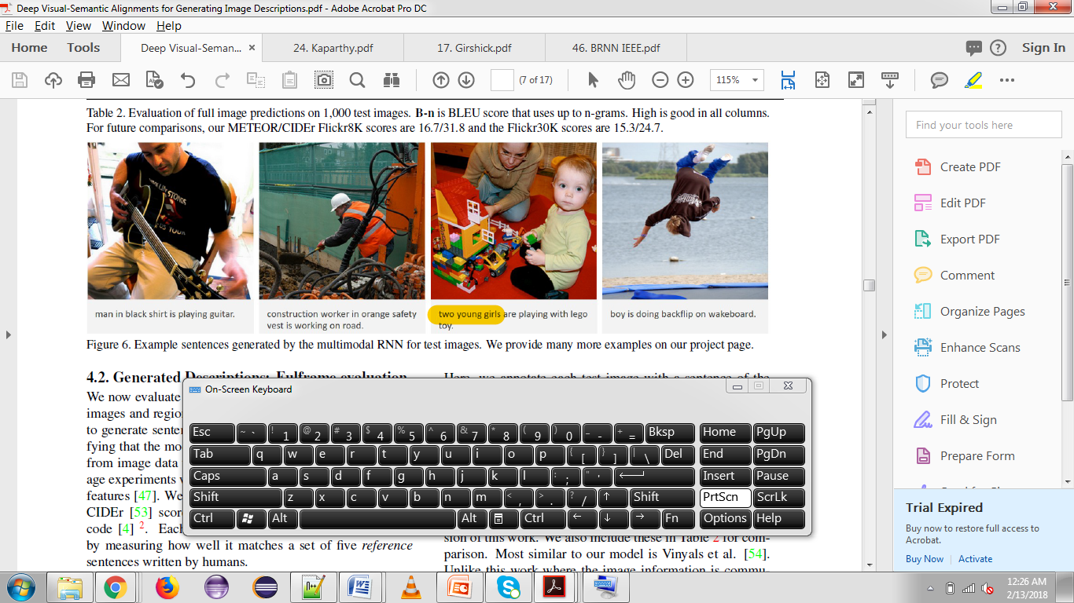
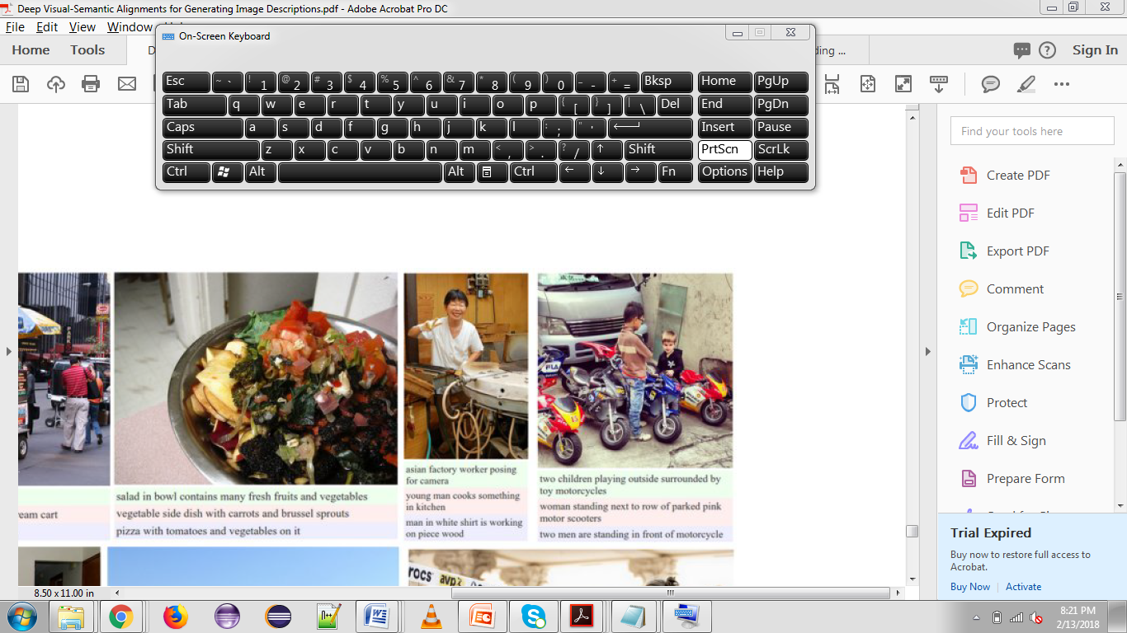
EXPERIMENTS & RESULTS : PART 2
Generated Descriptions : Fullframe Evaluations
Human ground truth ->
Generated sentence ->
Notes:
Checking the ability of the multimodal RNN

Slide 16
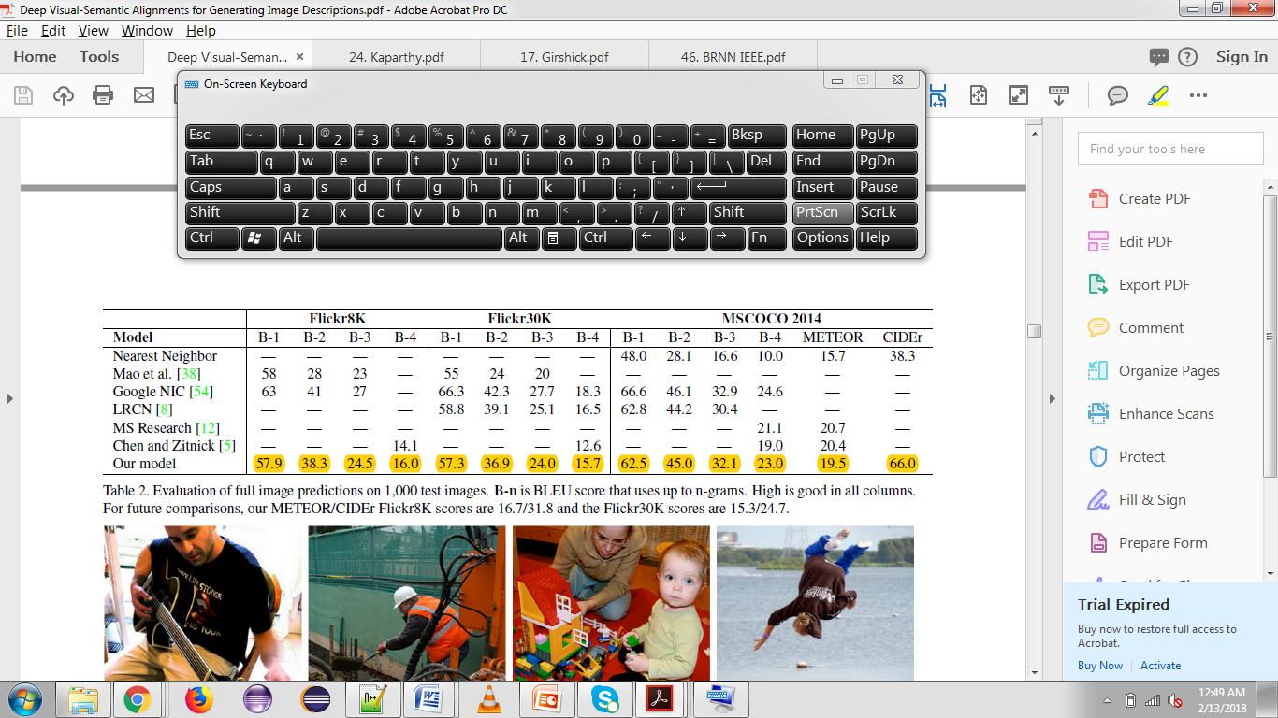
EXPERIMENTS & RESULTS : PART 2
Generated Descriptions : Fullframe Evaluations with BLEU scores
*Candidate sentence
compared with 5
reference sentences
Qualitative aspect
Wrong description for some cases
Comparison to previous work
Simplified and faster but slight degradation in performance
Outperform retrieval based methods
Notes:
BLEU – Bidirectional Evaluation understanding
Numerical translation for closeness metric
Corpus of human reference translations
These two things are required by the BLEU score
Uses n-grams – n words from sentence mapped with n-words in generated sentence
METEOR- Metric for evaluation of translation with explicit ordering
-based on harmonic mean for unigram precision and recall
CIDER- Consensus based image description evaluation – uses triplet human annotation
Checking the ability of the multimodal RNN

Slide 17
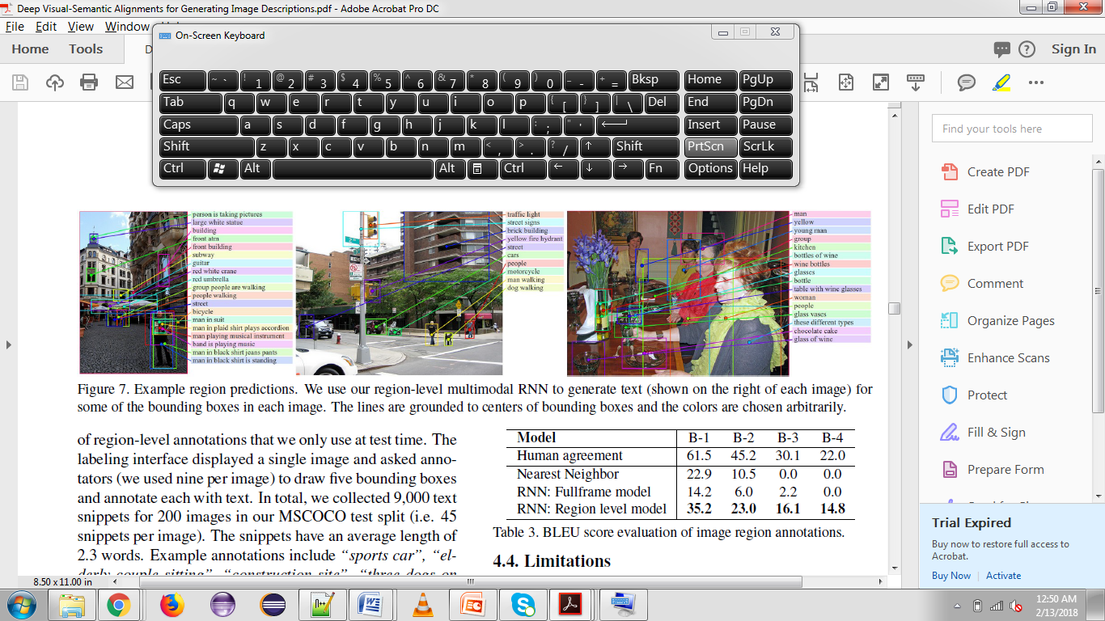
EXPERIMENTS & RESULTS : PART 3
Generated Descriptions : Region Evaluations

Slide 18
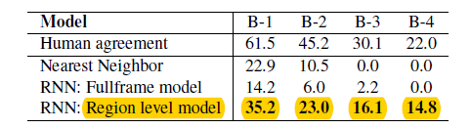
EXPERIMENTS & RESULTS : PART 3
Generated Descriptions : Region Evaluations
Optimizations
Outperforms full frame model
Notes:
Optimizations :
SGD – mini batches of 100 // performs updates for 100 training examples at a time
Momentum – 0.9 (hyperparameter) – helps accelerate gradient descent vectors in the right direction and helps SGDs to converge faster
Dropout regularization – learning less to learn better.Prevents overfitting. )reduces the interdependent learning amongst neurons
RMSProp – Gradient descent optimization algorithm (Adadelta, Adagrad)
Gradient clipping – between 2 values(at 10). Prevents blowing up of values. Prevents a batch (like mini-SGD) from spoiling your previous calculations
Learning rate - howquickly the network abandons old beliefs for new ones. Deteremines the steps you take and helps in avoid changes

Slide 19
CONCLUSIONS
Limitations:
Less expressive method to pass image information to RNN
Unsolved problem : Using one model to translate from image-sentence dataset to regional-level annotation
Generates a description of one input array of pixels at a time without context
Significance of the topic
Healthcare – cancer tissues, x-ray scanning
Activity detection
Notes:
More expressive – multiplicative RNNs / LSTM for passing it in a better way
http://www.cs.utoronto.ca/~ilya/pubs/2011/LANG-RNN.pdf - multiplicative RNN

Slide 20
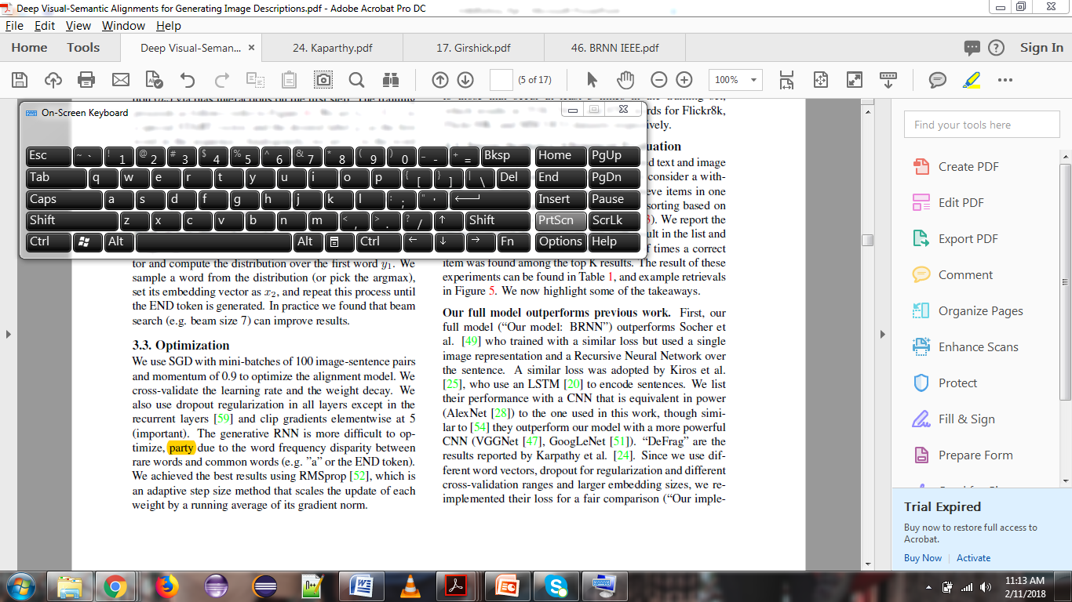
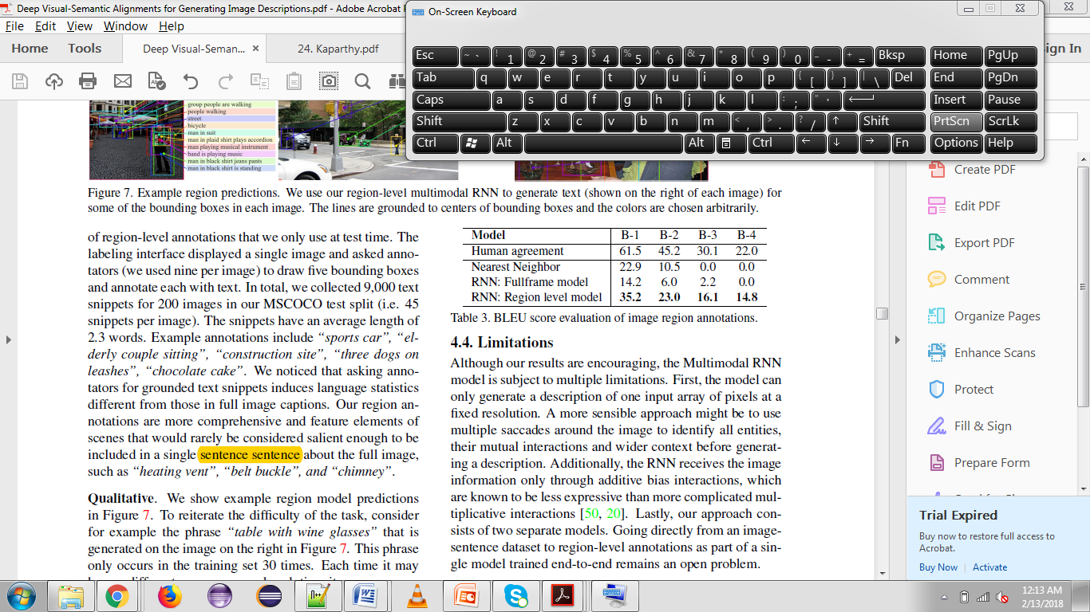
PROS & CONS
PROS:
Simplifications from previous paper on which it is based, which improve performance
Good at generating regional level descriptions
Model identifies discriminative words in images and assigns higher probabilities to them
Supplementary materials at end of paper- rich in images and examples
Cited 1300 times
CONS:
Model not good at localizing objects in an image
Usage of two different architectures of CNN for two parts
No reference of how top 19 locations for image chosen
Colors are embedded in same space in language context however visually they are different
Spelling mistake
Notes:
LSTM instead of BRNN, may improve performance.
Train on AlexNet and VGGNet for generating full image descriptions. More powerful CNN uses batch normalization in the CNN (uses end to end model – with LSTM)
BRNNs instead of dependency tree to model for word representations, simplifying objective function)
Usage of which word embedding matrix is not mentioned
Learns to modulate the importance of the words and regions by scaling their corresponding magnitude of their vectors.
Therefore discrimunative words have higher magintude in the embedding space which translates to a higher influence on the the final image-sentence scores due to inner product

Slide 21
THANK YOU QUESTIONS??

